Slide 1
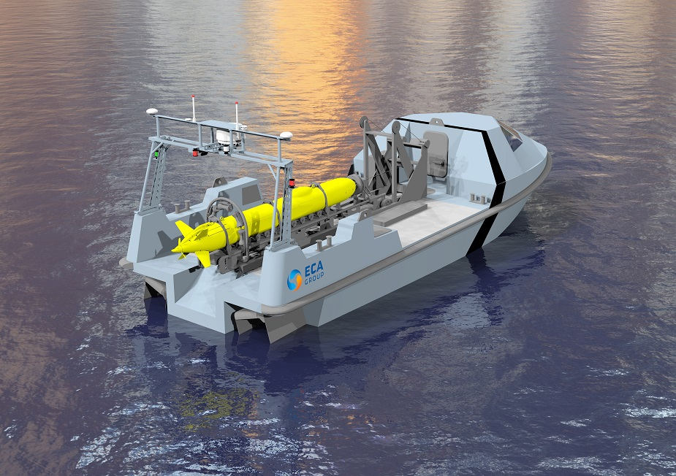
Final Presentation USV Control System
Image from Naval Recognition
Notes:
Good Morning and welcome to my final presentation, I will begin with a background and motivation of my project. Followed by a description of my system, the testing and results and finally look at some issues that came up in the project and the solutions to these issues.

Slide 2
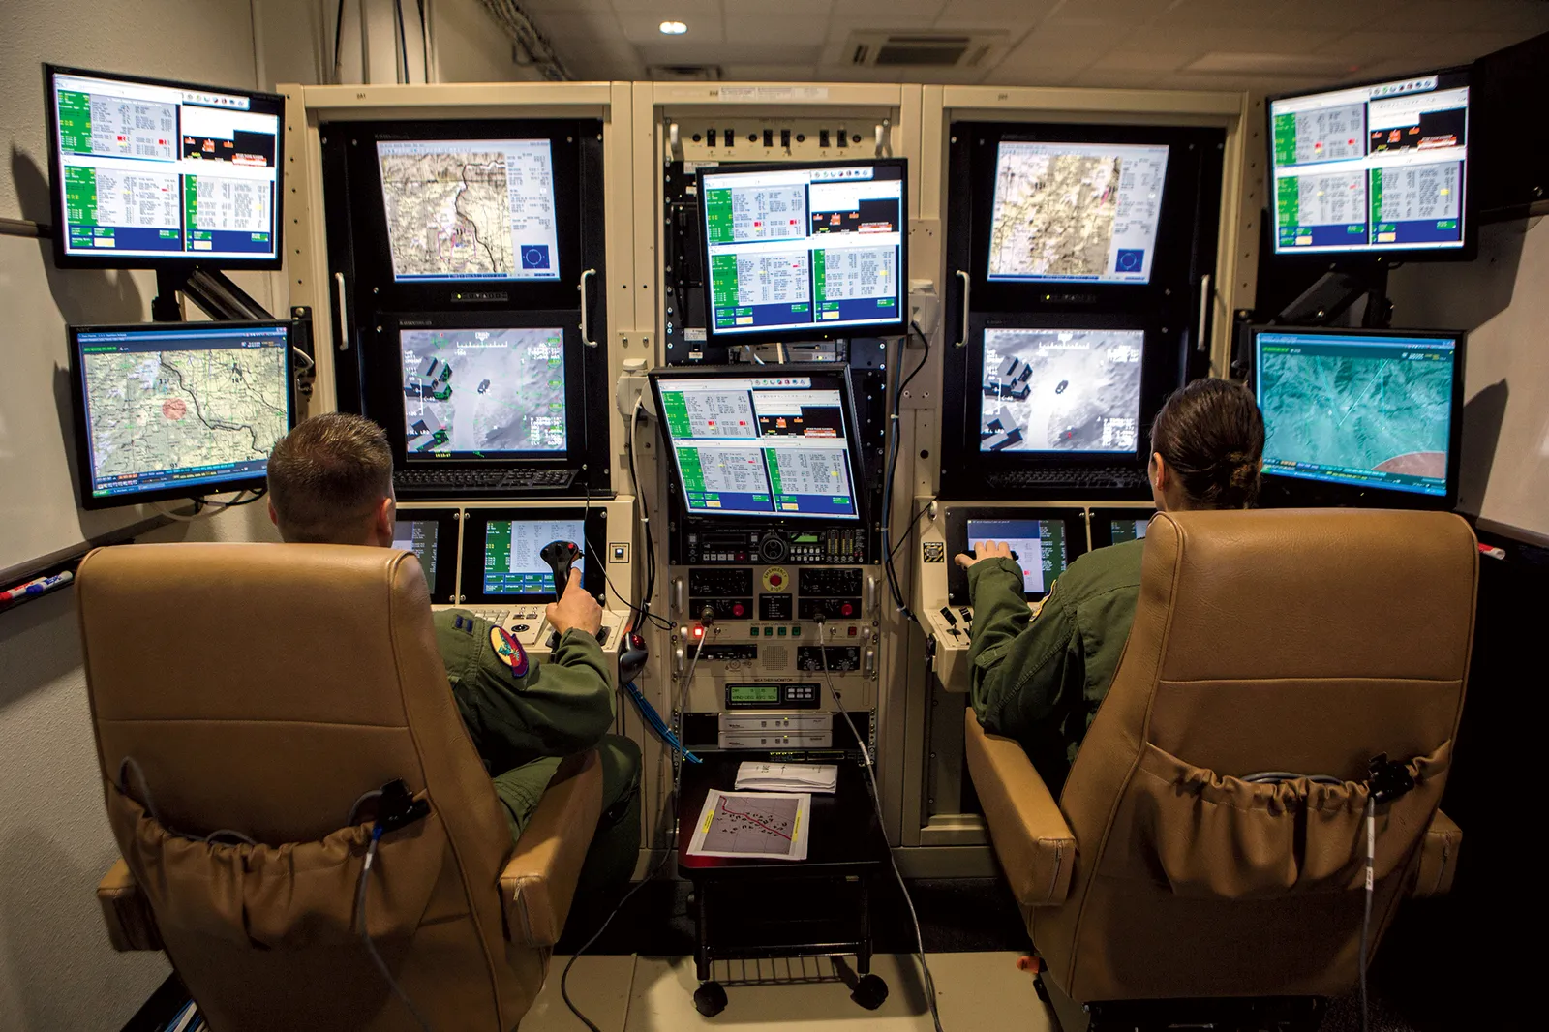
Background
USV
Unmanned Surface Vessel.
Independent Control.
Autonomous Steering.
Obstacle Avoidance.
Active Positioning Knowledge.
Off-site Control.
Open Communication Connection.
Image from GQ
Notes:
To start with, the scope of this project is to design and implement a control system for an electric USV. A USV stands for an unmanned surface vessel. A USV can either be fully independent and make use of automated steering and possibly obstacle avoidance. For independent control, the USV needs to have an active knowledge of its current position using a combination of GPS data and digital Compass. Or a USV can be controlled from an off-site location and will therefore only need to have an open communication connection between the USV and the site from where it is being controlled. In this project I will be focusing of creating an independent control USV with the focus being on the design and implementation of the control system.

Slide 3
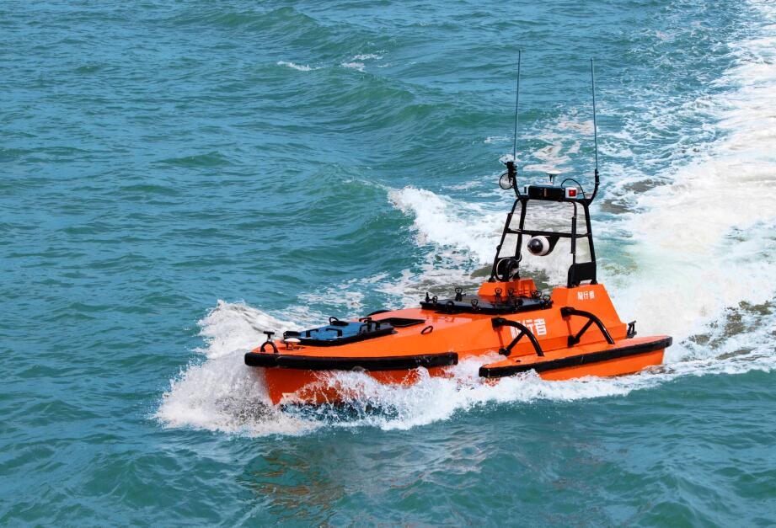
Background
Motivation
Military.
Patrolling.
Fire Support.
Research.
Marine Surveying.
Rescue.
Remote Response Time.
Image from OceanAlpha
Notes:
USVs are incredibly useful and could save a lot of money as they would be cheaper to operate and have a lower carbon footprint than conventional manned vessels. The uses of USVs ranges from the military where they can be used similarly to UAVs for either patrolling or fire support. USVs would also have great uses in the world of marine and nature surveying. These USVs can be fitted with monitoring equipment and together with a data link and solar panels would be able to be constantly recording and transmitting data back to research facilities without having to come in for resupplies. Its only need to come in would be for scheduled or unscheduled maintenance and repairs. Finally, USVs can even be used as part of naval rescue by either having them patrolling remote areas and therefore reducing the response time to distress calls or being able to be sent into situations that might otherwise be deemed too dangerous for manned vessels.

Slide 4
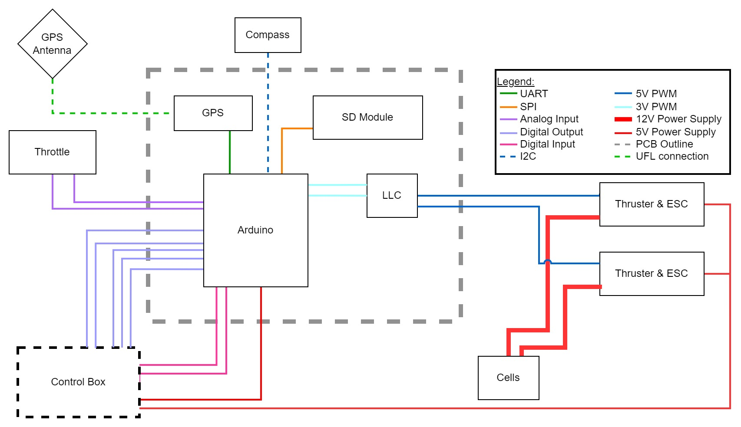
System Schematic
Notes:
This is the system schematic. Inside the grey dashed area is the PCB, on which is the Arduino microcontroller, the GPS module and the Logic level converter to switch up the PWM signal from the arduinos 3V to the ESC required 5V. Outside of the grey area is the throttle system, GPS, Compass, Control Box the two thrusters which are complete units with their ESC and the Battery cells. The throttle is made up of two linear pots operating between 0 and 3V. Their signal is parsed to the Arduino ADC. The Arduino outputs two 3V PWM signals which are stepped up by the LLC and then parsed on to the thrusters. The high current draw is directly to the thrusters. The gps module operates on 3V and transmits data to the Arduino using UART. The compass also uses 3V power and uses I2C communication. Finally, the control box consists of switches to change the state of the system and Status LEDs to give feedback to the user.

Slide 5
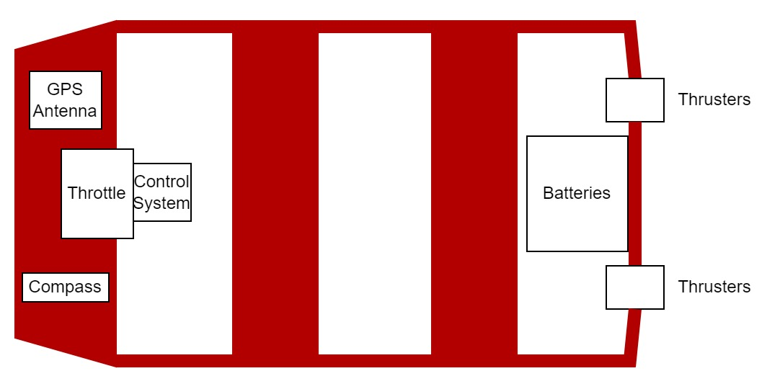
Physical System
System Description
Spider 3 Boat.
POT Throttle System
TD20 Thrusters & ESC.
2 12V Lead-Acid Batteries.
Arduino DUE Microcontroller.
GPS Module.
Digital Compass.
Photo by Luke Kingwill
Notes:
Here is the physical system. It consists of the Spider 3 boat, the two TD20 thrusters and their ESC, a 24V battery system, the Arduino microcontroller, GPS module and the throttle system. The thrusters are mounted onto the back of the boat and the battery cells are position in the well at the back so that the cables which are carrying the high current are as short as possible. The throttle will be mounted on the front bench for ease of use and the PCB will be mounted in close proximity so that the GPS and compass modules are as far from the magnetic fields of the motors and high current cables as possible.

Slide 6
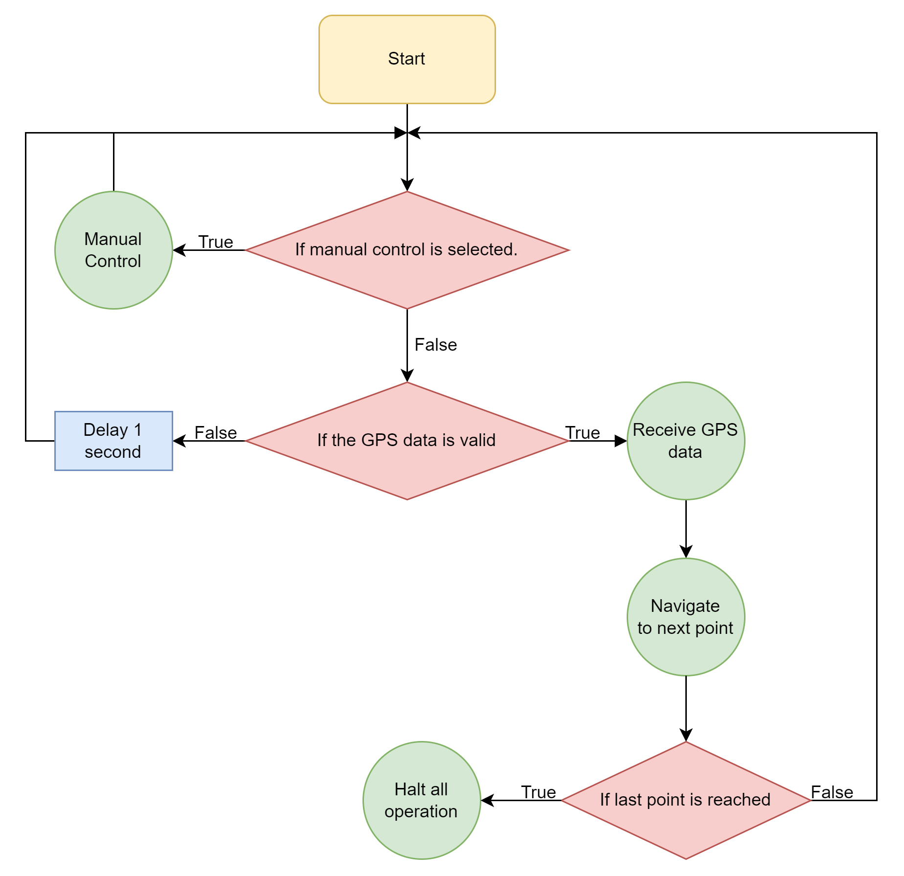
Control System Logic
System States
Three Operating States.
Manual Navigation.
Autonomous Navigation.
Idle State.
Photo by Luke Kingwill
Notes:
The system has three operating states: manual navigation whereby the throttle is used to receive user input and control the thruster. Autonomous navigation whereby the vessel will self navigate to the GPS locations preloaded into the system and the Idle state where the vessel stops all operation once it has completed its navigation route.

Slide 7
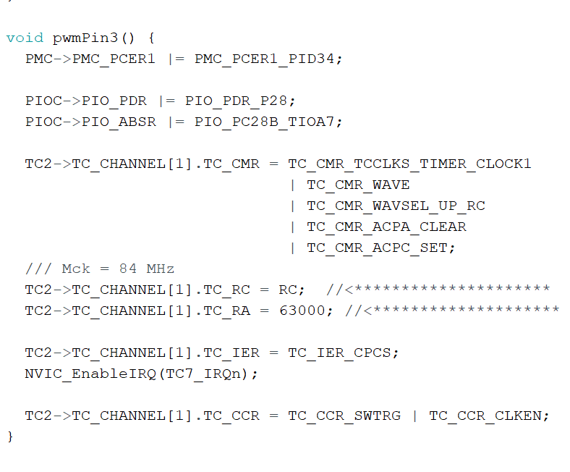
Control System Logic
Manual Control
Analog Read.
Adjust Timer Duty Cycle.
Update PWM Output.
Receive GPS Data.
Notes:
The analogue value is read by the MCU and the throttle position is determined from calibrated extremes given in table 3.1. The duty cycle is updated by adjusting the RA value in the timer registers. This updates the PWM output signal. Finally the current GPS location from the GPS module is saved.

Slide 8
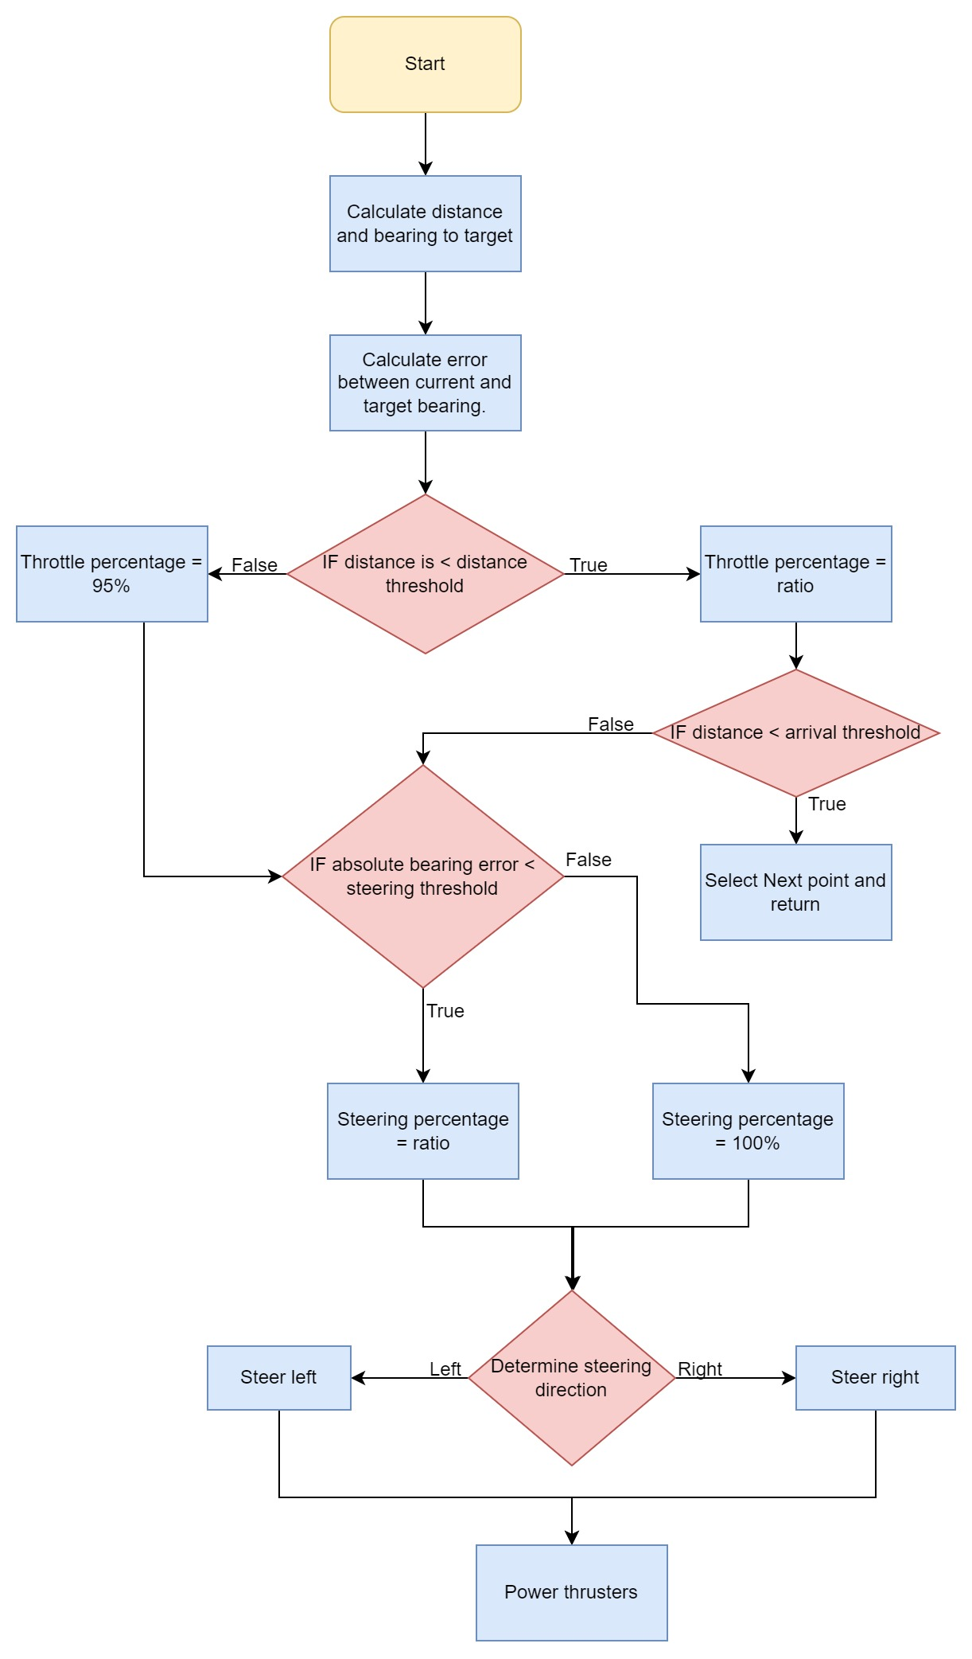
Control System Logic
Autonomous Control
Calculate Distance and Bearing.
Calculate Error.
Apply Proportional Throttle.
Apply Proportional Steering.
Determine Steering Direction.
Update PWM Signals.
Photo by Rob Pike
Notes:
Calculate the bearing and distance to target. Calculate the error between the current bearing from the compass and the target. Apply the proportional control to throttle. Apply proportional control to the steering. Determine the steering direction. Determine the max and min between the current and target bearing. Two condition (target = max) XOR max – min > 180 then steer left else steer right.

Slide 9
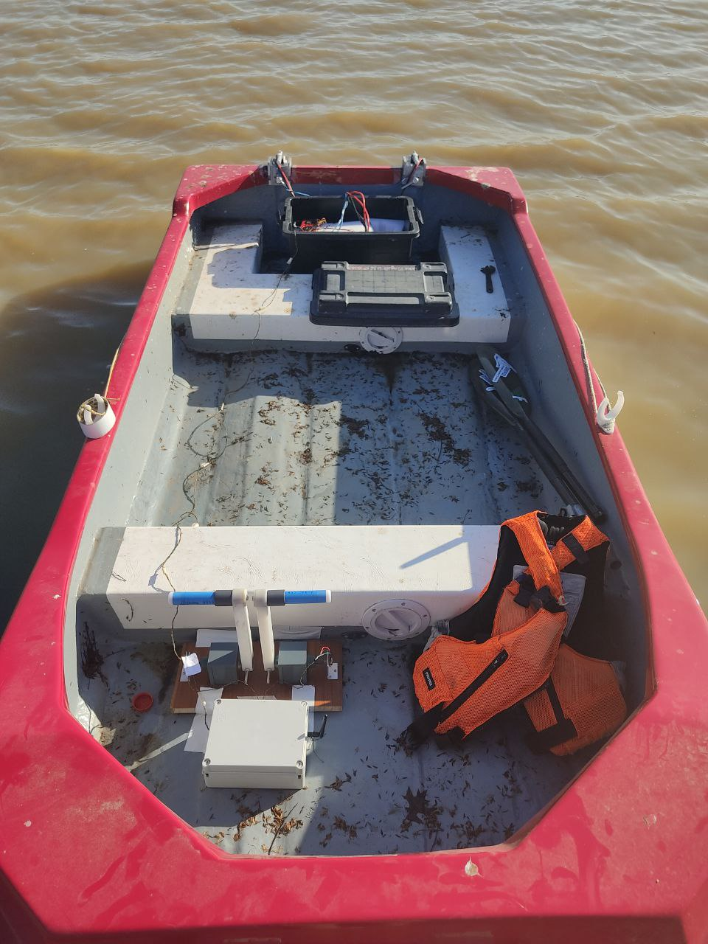
Testing
Safety & Setup
Safety Checklist (Table 4.1)
Vessel is Always Manned.
Electrical Connections Waterproofed.
Setup Checklist (Table 4.2)
Photo by Luke Kingwill
Notes:
There is a safety checklist to be completed in table 4.1 than lists all the safety requirements before setting off. The vessel is always manned. The electrical connections were waterproofed as best as possible. Silicon self sealing adhesive tape. Finally a vessel setup checklist in table 4.2 to be followed on the correct setup procedure and order. Includes making sure the power is off before connecting the batteries.

Slide 10
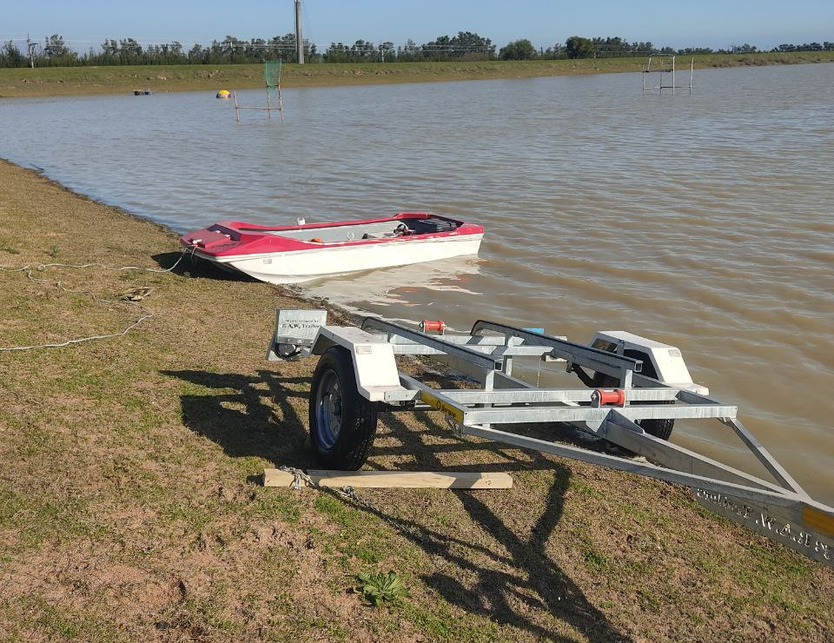
Results
Sub-System
GPS and Compass.
PWM Output.
Throttle Input.
Thruster Control.
Photo by Luke Kingwill
Notes:
Tested at the Stellenbosch canoe club dam just outside of Stellenbosch pictured. The main elements were individually tested before the final full system test was done. GPS and compass used a mobile phone app to set a baseline. PWM output and throttle input measured using an oscilloscope. The thruster control tested with the thruster in a bucket of water, as they are not designed to be dry run.

Slide 11
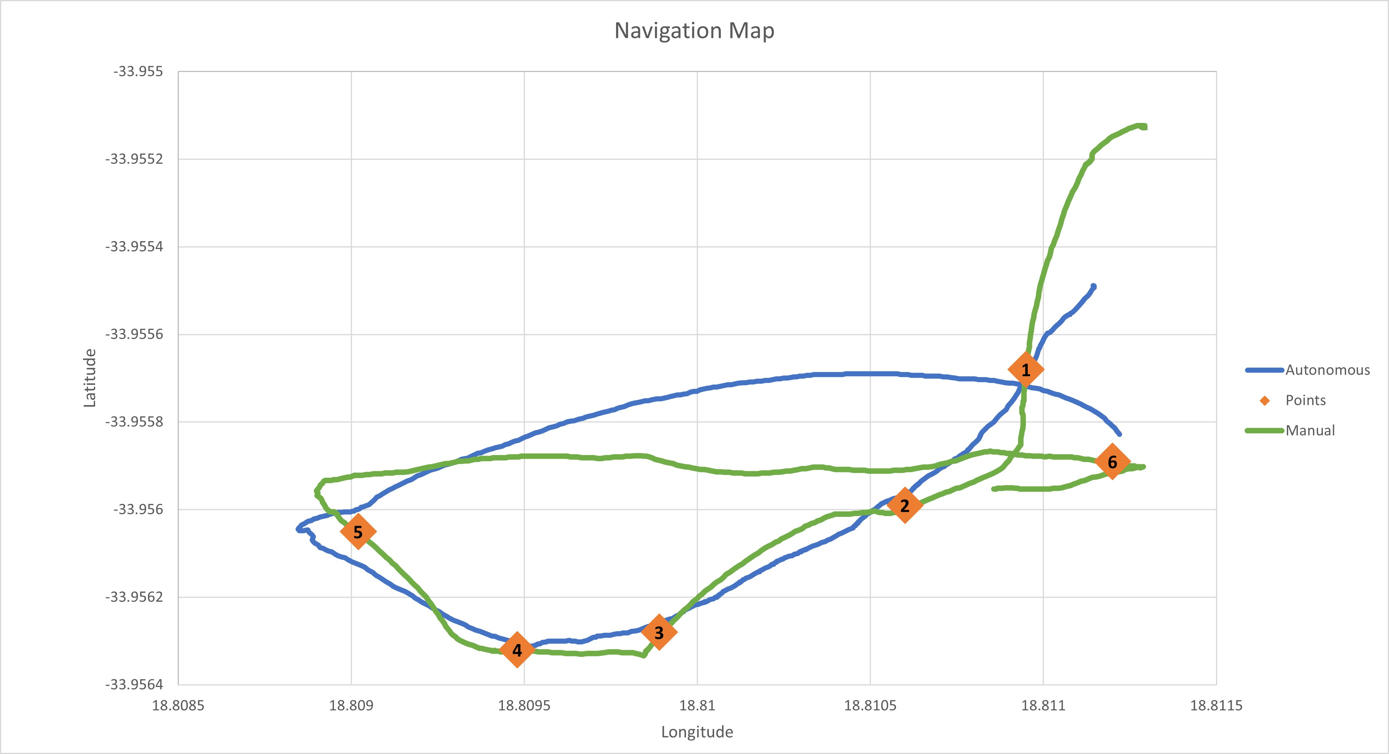
Results
Full System
All Passed.
Windy Conditions.
System Performed Well.
Notes:
Full system test shown in the diagram. Manual control (green) used to set the navigation points. Autonomous test (blue) then run again on the same points. Know the points are accurate and the path can be compared between the two runs. The overall test went well and the vessel navigated to all the points. The conditions were windy with the wind from the SW. can be seen between points 5 & 6. The system kept making corrections and finally navigated to the final point.

Slide 12
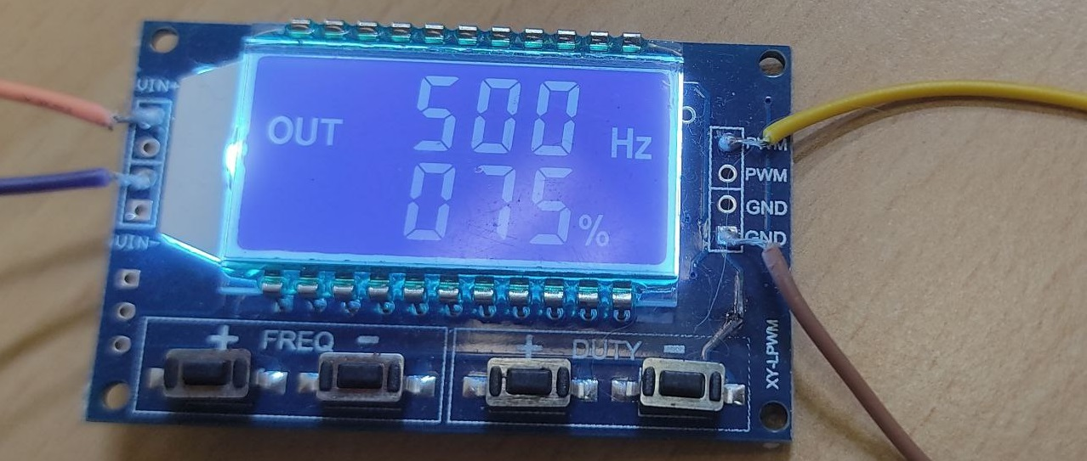
Problems and Solutions
Issues that Arose
Under Powered.
Blown ESC.
Thruster Control.
Throttle Redesign.
Compass Calibration.
Photo by Luke Kingwill
Notes:
Initially the vessel was underpowered with the 12 V batteries. More LiFePO batteries were expensive and hard to get hold of. Switched to 2 12V Lead acide batteries. Not ideal. Kept the running to a minimum and made sure the batteries weren’t drained too much. Mistake blew an ESC. Had to order a new one and used expoxy to seal the connection as it is a submerged ESC. Thrusters and their ESC didn’t have good datasheets (listed forward and reverse in us) and struggled to get them to respond and turn on. Used the PWM signal generator to try a wide range of frequencies and Duty cycles until the thrusters responded. Throttles ordered were too small and limited range of motion. Designed a new throttle with POTs and E&E workshop built it from PVC.
First test failed due to compass calibration. Very sensitive to any magnetic fields around it. Spent a lot of time recalibrating until I was satisfied with the calibration and rerun the test. Thrusters were not equivalent in power.

Slide 13
Conclusion
The System Performed Well.
Improvements:
Larger Power Supply.
Improved Thrusters.
Further Developments:
Obstacle Avoidance.
Return to Home Functionality.
Power Regeneration:
Solar Panels.
Notes:
In conclusion the control system performed well and the navigated to all the points successfully even with the windy conditions. Improvements could be made by using a larger power supply to increase the power of the thruster. Better quality thrusters with better resolution would be able to provide finer motor control and the thruster did not seam evenly powered. Slight drift at full throttle.
Further developments to the system can be undertaken to improve the system and make it more usable would be to add obstacle avoidance above and below the waterline. and with that you can add a return to home feature whereby the system can avoid any obstacles on the return home. Finally adding some sort of power regeneration such as solar panels would be able to improve the range of the vessel.

Slide 14
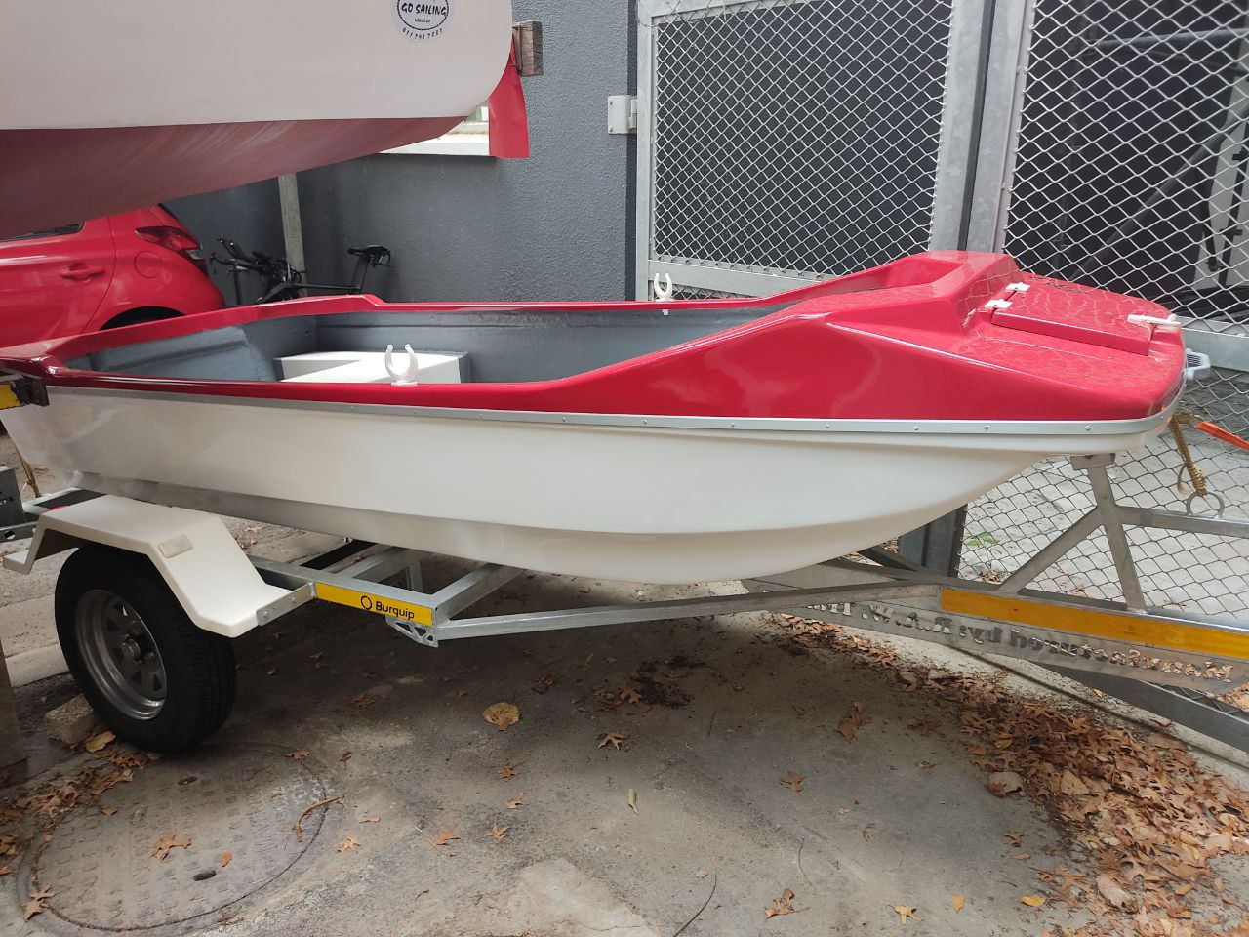
Thank you
Enkosi
Dankie
Photo by Luke Kingwill
Notes:
Thank you and are there any questions.

